Slide 1
KEY POINTS OF CHAPTER 6
Graphs and Trees.
Graphs Terminology.
Categories of Graphs.
Types of Graphs.
Trees Terminology.
Key Differences Between Graphs and Trees.
Representation of Graphs and Trees in Computers.

Slide 2
TREES AND GRAPHS
Trees and graphs are both abstract data structures. They are a non-linear collection of objects, which means that there is no sequence between their elements as it exists in a linear data structures like stacks and queues.
Trees and graphs are data structures used to resolve various complex problems.

Slide 3

Graphs

Slide 4
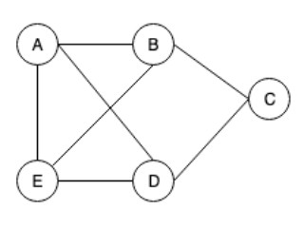
GRAPHS
A graph can also be defined as a collection of entities called vertices (nodes/points), connected to each other through a set of edges. The set of
edges (lines/arcs) describes the relationships
between the vertices.
A graph G is defined as follows: G=(V, E) V(G): a finite, nonempty set of vertices.
E(G): a set of edges.
V={a, b, c, d, e}
E={(ab),(ad),(ae),(bc),(be),(cd),(ed)}

Slide 5
GRAPHS TERMINOLOGY
Vertex: each node of the graph.
Edge: a path or a line between two vertices.
Path: a sequence of edges between the two vertices.
Cycle: a path where the first and last vertices are the same.
Adjacency: two nodes or vertices are adjacent if they are connected to each other through an edge.

Slide 6
ADJACENCY
In a graph, two vertices are said to be adjacent, if there is an edge between the two vertices. Here, the adjacency of vertices is maintained by the single edge that is connecting those two vertices.
In a graph, two edges are said to be adjacent, if there is a common vertex between the two edges. Here, the adjacency of edges is maintained by the single vertex that is connecting two edges.

Slide 7
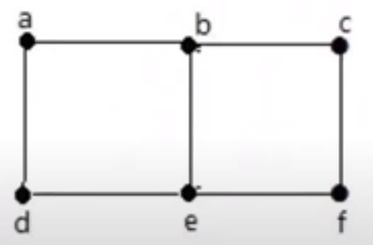
ADJACENCY
In the following graph:
'a' and 'd' are the adjacent vertices, as there is a common edge 'ad' between them.
'a' and 'b' are the adjacent vertices, as there is a common edge 'ab' between them.
' ab' and 'be' are the adjacent edges, as
there is a common vertex 'b' between them.

Slide 8
CATEGORIES OF GRAPHS
Graphs can be:
Directed vs Undirected
Weighted vs Unweighted
Connected vs Disconnected
Cyclic vs Acyclic.
Sparse vs Dense.

Slide 9
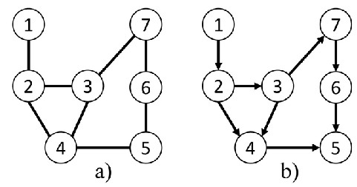
UNDIRECTED AND DIRECTED GRAPHS
When the edges in a graph have no direction, the graph is called undirected.
When the edges in a graph have a direction, the graph is called directed (or digraph).

Slide 10
DEGREE IN DIRECT AND UNDIRECT GRAPH
Degree in undirected graphs:
Degree(V) = # of adjacent (incident) edges to vertex v in G.
Σ degrees = 2 |E|
Degree in directed graphs:
In-Deg(V) = # of incoming edges.
Out-Deg(V) = # of outgoing edges.
Σ In-degree = Σ Out-degree = |E|

Slide 11
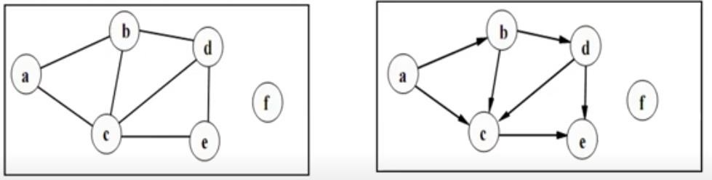
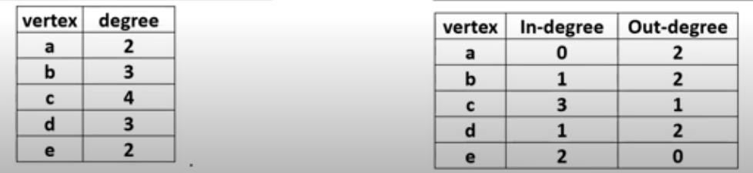
DEGREE IN DIRECT AND UNDIRECT GRAPH

Slide 12
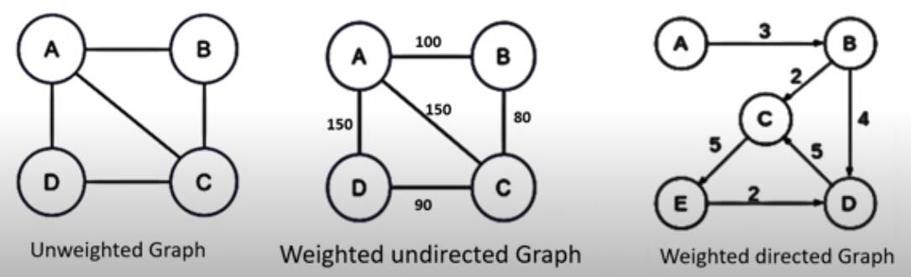
WEIGHTED AND UNWEIGHTED GRAPH
If edges in the graph have weights, then the graph is said to be a weighted graph, if the edges do not have weights, the graph is said to be unweighted.
A weight is a numerical value attached to each individual edge.
Weights may represent distance, cost, time etc.

Slide 13
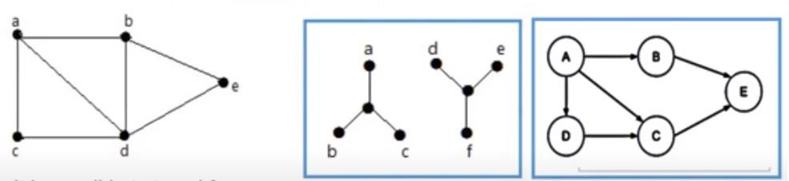
CONNECTIVITY:
CONNECTED AND DISCONNECTED GRAPH
A graph is said to be connected if there is a path between every pair of vertices. From
every vertex to any other vertex, there should be some path to traverse.
It is possible to travel from one vertex to any other vertex.
It can traverse from vertex 'a' to vertex 'e'
Traversing from vertex 'a' to vertex 'f' is not possible
- No Path
Not possible to traverse to 'a'
using the path 'a-b-e'.

Slide 14
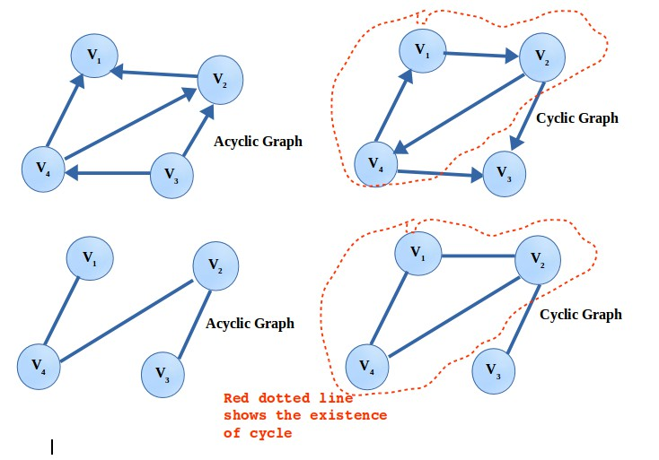
CYCLIC AND ACYCLIC GRAPH
A graph is said to have a cycle if you start from a node/vertex and after traversing some nodes, you come to the same node, then you can say that the graph is having a cycle.
If there is a cycle in a graph, then that graph is called Cyclic Graph. If there is no cycle present in the graph, then that graph is called an Acyclic Graph.
•
For a Cyclic
necessary.
Graph, at least one cycle is

Slide 15
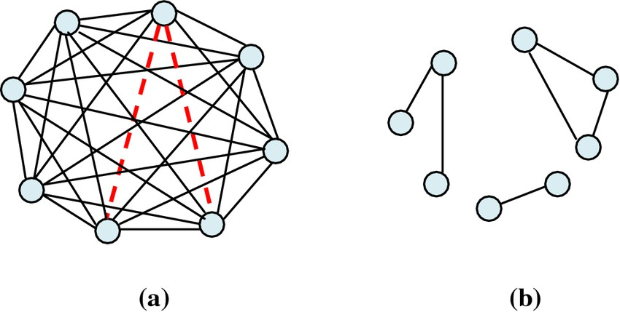
SPARSE AND DENSE GRAPH
Sparse Graph: A graph in which the number of edges is much less than the possible number of vertices.
Sparse Graph: A sparse graph is a graph
G = (V, E) in which |E| = O(|V|).
Dense Graph: A graph in which the number of edges is close to the possible number of vertices.
Dense Graph: A dense graph is a graph
G = (V, E) in which |E| = O(|V|²).

Slide 16
TYPES OF GRAPHS
Null Graph.
Multi Graph.
Regular Graph.
Complete Graph.

Slide 17
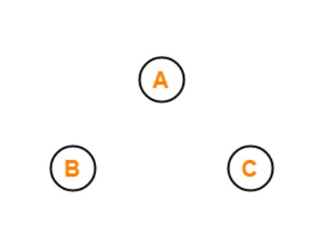
NULL GRAPH
A null graph is a graph containing no edges.

Slide 18
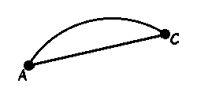
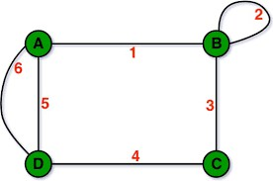
PARALLEL EDGES AND MULTI GRAPH
Parallel Edges
In a graph, if a pair of vertices is connected by more than one edge, then those edges are called parallel edges.
In the following example: 'a' and 'c' are the two vertices which are connected by two edges 'ac' and 'ca' between them.
Multi Graph
A graph having parallel edges is known as a Multigraph.

Slide 19
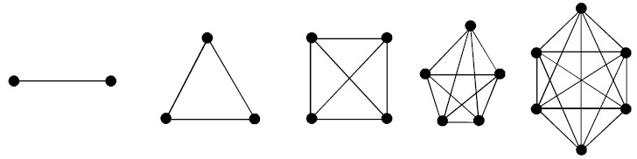
REGULAR GRAPH
Regular graph is a graph where each vertex has the same number of neighbors (every vertex has the same degree).
1-regular
2-regular
3-regular
4-regular
5-regular

Slide 20
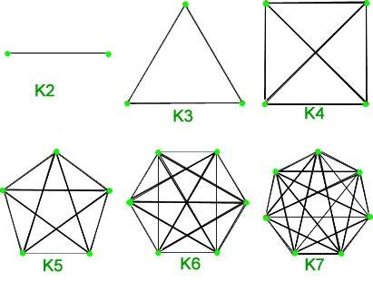
COMPLETE GRAPH
A graph G is Complete Graph (G_{N}) if every node u in G is adjacent to every other node v in G.
A complete graph is already connected.
# of edges = n(n-1)/2

Slide 21
Trees

Slide 22
TREES
A tree is a nonlinear data structure, compared to arrays, linked lists, stacks and queues
which are linear data structures.
A tree can be empty with no nodes, or a tree is a structure consisting of one node called the root and zero or one or more subtrees.
They don’t have any cyclic relations and there is only one path to a particular node.
A tree must be connected which means there must be a path from the root to all other nodes.

Slide 23
TREES TERMINOLOGY
Root: the top (initial) node of the tree, where all the operations start.
Node: each item in the tree, usually a key-value.
Edge: a tree has n-1 edges (where n is the number of nodes) representing the connection between two nodes.
Parent: a node which is a predecessor of any node.
Child: a node which is descendant of any node.
Siblings: a group of nodes which have the same parent.
Leaf (terminal) node: a node without children.

Slide 24
TREES TERMINOLOGY
Level: is the number of edges on the path from the root node to n.
The level of the root node is zero.
Also, it defined as 1 + the number of edges between the node and the root.
Height: the number of edges from its root to the furthest leaf.
Sub-tree: a portion of a tree data structure that can be viewed as a complete tree in itself
There are different types of trees that you can work with, like Binary Tree, Binary Search Tree, Red-Black tree, AVL tree, Heap, etc. The deciding factor of which tree type to use is performance. Since trees are data structures, performance is measured in terms of inserting and retrieving data.

Slide 25
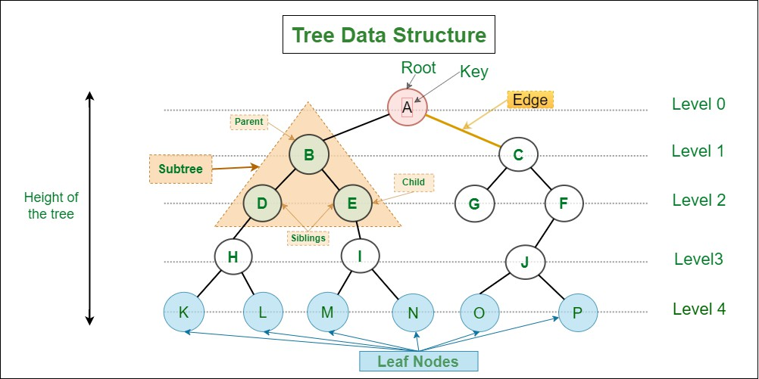
TREES TERMINOLOGY

Slide 26
Key Differences Between Graphs and Trees

Slide 27
KEY DIFFERENCES
BETWEEN GRAPHS AND TREES
Trees and graphs are mainly differentiated by the fact that a tree structure must be
connected and can never have loops while in the graph there are no such restrictions.
In trees, all nodes must be reachable from the root and there must be exactly one possible path from the root to a node. In graphs, there are no rules dictating the connections among the nodes.
Main use of graphs is coloring and job scheduling, on the other hand main use of
trees is for sorting and traversing.

Slide 28
KEY DIFFERENCES
BETWEEN GRAPHS AND TREES
In graphs, the number of edges doesn’t depend on the number of vertices. On the contrary, if a tree has “n” vertices (nodes) then it must have exactly “n-1” edges.
There must be a root node in a tree while there is no such concept in a graph.
Basically speaking, a tree is just a restricted form of a graph (connected acyclic graph). Also known as a minimally connected graph. That makes graphs more complex structures compared to the trees due to the loops and circuits, which they may have.

Slide 29
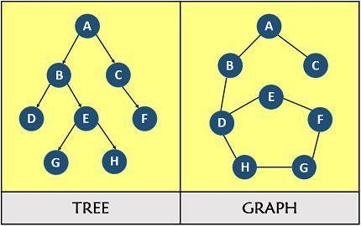
EXAMPLE OF A TREE AND A GRAPH

Slide 30
Representation of Graphs and Trees in Computers

Slide 31
Representation of Graphs in Computers

Slide 32
GRAPH REPRESENTATION
Different data structures for the representation of graphs are used in practice:
Adjacency Matrix.
Adjacency List.
Incidence Matrix.

Slide 33
GRAPH REPRESENTATION: ADJACENCY MATRIX
A two-dimensional matrix, in which the rows represent source vertices and columns represent destination vertices. Only the cost for one edge can be stored between each pair of vertices.
Size: V × V, where is the number of vertices in the Graph.
adjMatrix[i][j] = 1 when there is an edge b/w Vertex i and Vertex j, else 0.

Slide 34
GRAPH REPRESENTATION: ADJACENCY LIST
Adjacency List is the Array[] of Linked List, where array size is same as number of vertices in the graph. Every Vertex has a Linked List.
Each node in this linked list represents the reference to the other vertices which share an edge with the current vertex. The weights can also be stored in the linked list node.

Slide 35
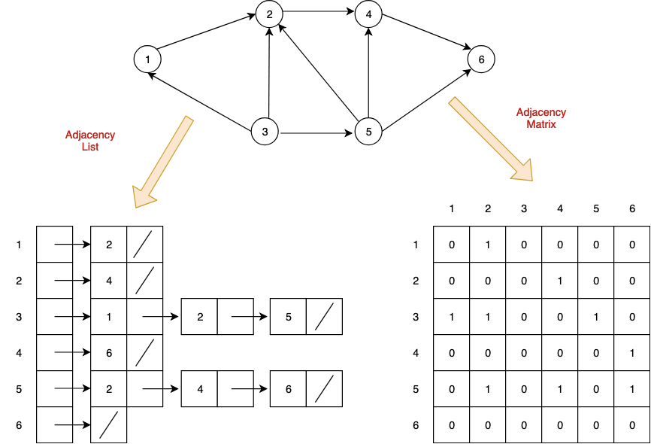
GRAPH REPRESENTATION

Slide 36
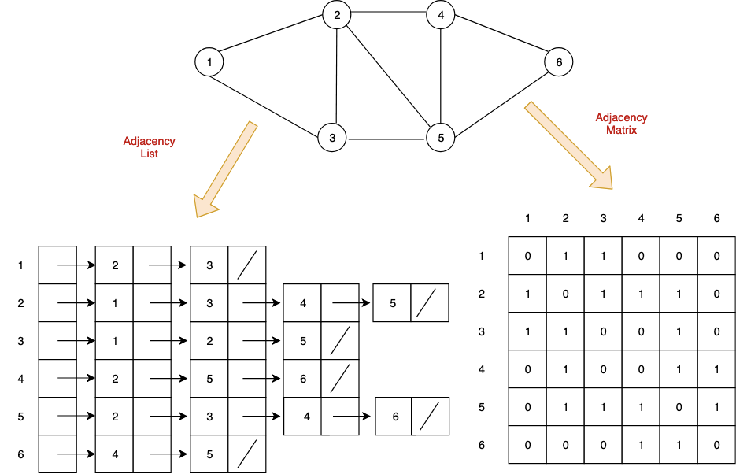
GRAPH REPRESENTATION

Slide 37
Representation of Trees in Computers

Slide 38
TREE REPRESENTATION
Different data structures for the representation of trees are used in practice:
Arrays
Linked List
Single linked list
Double linked list

Slide 39
TREE REPRESENTATION: ARRAY
To represent a binary tree of depth 'n' using array representation, we need one dimensional array with a maximum size of 2n + 1.
If the node is at i-th index
Left child at: [(2*i) +1]
Right child at: [(2* i)+2]
Parent: floor [(i-1)/2]

Slide 40
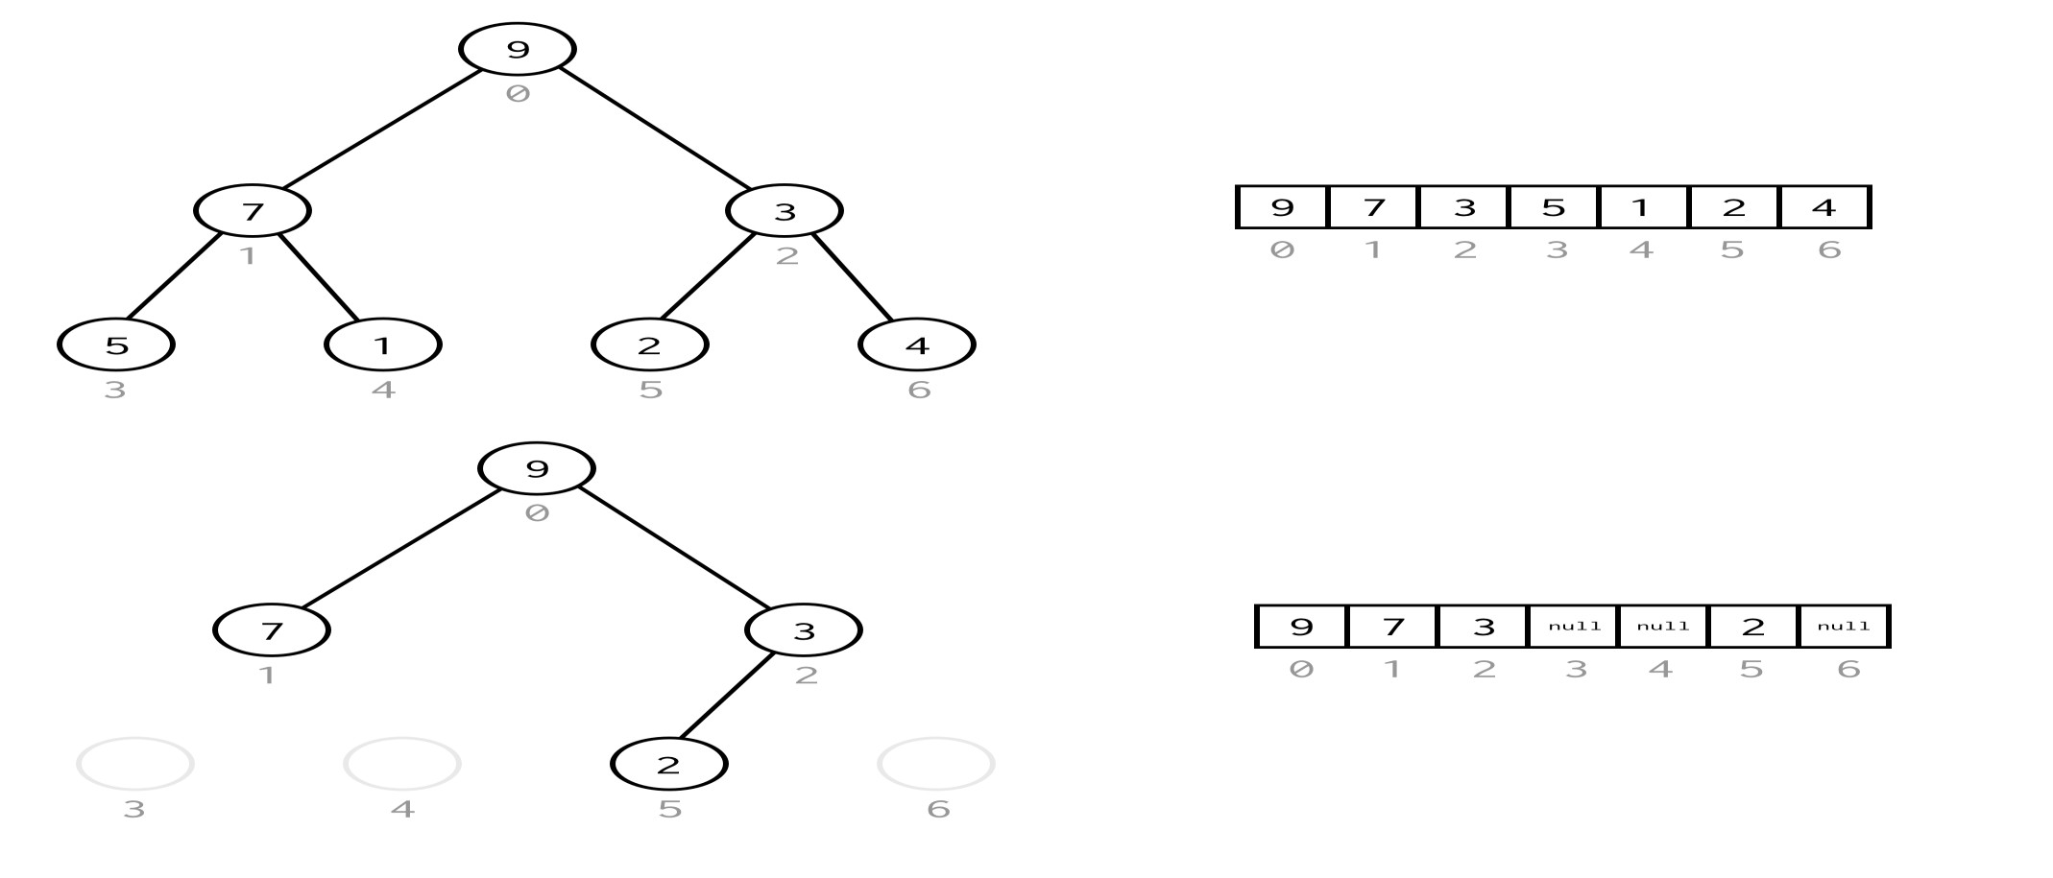
TREE REPRESENTATION: ARRAY

Slide 41
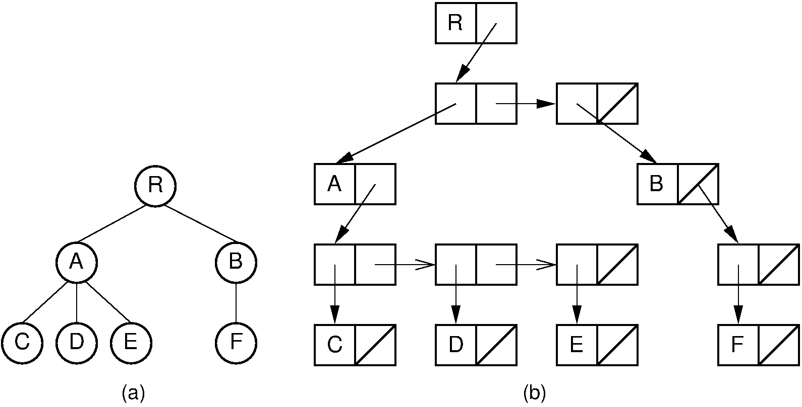
TREE REPRESENTATION: SINGLE LINKED LIST
Two types of nodes are used: one for representing the node with data called 'data node' and another for representing only references called 'reference node'.

Slide 42

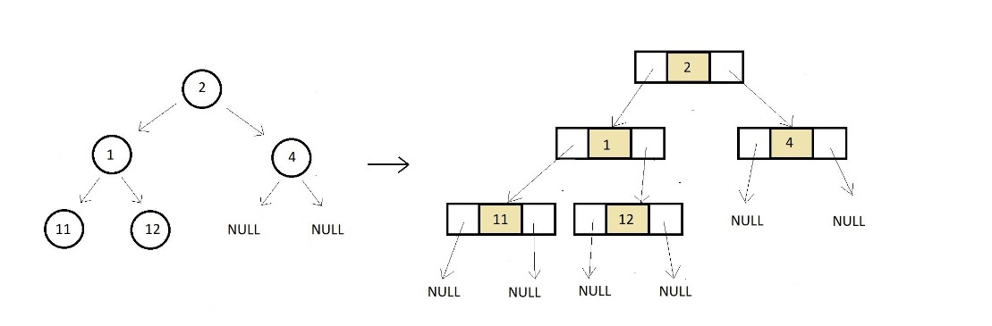
TREE REPRESENTATION: DOUBLE LINKED LIST
In a doubly-linked list, every node consists of three fields. The first field is for storing the left child address, the second for storing actual data, and the third for storing the right child address.

Slide 43
END OF CHAPTER 6 – PART1

